Slide 1
Speech Recognition and AI system using Python
- Virtual Assistant
Let’s start …...

Slide 2
Name of Institute : Government Polytechnic Karad
Name of Supervisor : Ms. S. B. Patil
Branch of Engineering : Computer Engineering
Sixth semester of Institute Government Polytechnic , Karad (0010) In course Capstone Project – Execution and Report Writing (22060)
JULY 2021

Slide 3
# AI For Good…

Slide 4
AGENDA
1 | Abstract
2 | Objectives
3 | Problem Statement
4 | Speech recognition
5 | Features
6 | UML Diagrams
7 | Snapshots
8 | Applications
9 | The Way Ahead
10 | Overview of 12 week plan

Slide 5
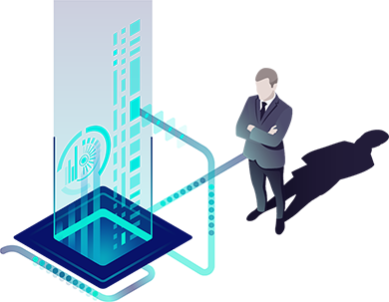
Abstract
This report represents the project report on a project entitled " Speech Recognition and AI System using Python" as a part of the curriculum for the sixth semester project of Diploma in Computer Engineering.
The report discusses various methods and implementation techniques to build the system of IVR system with speech recognition and presents the results of the system being implemented.
This project is a simple approach to developing a system where the speech recognition is embedded within another system to automate task using speech as input command.

Slide 6
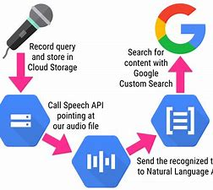
Objectives
To make use of domain specific models and algorithms in field of speech recognition.
To develop an interactive voice response.
To understand the basics of speech processing.
To get knowledge on various speech recognition approaches.
To get insights on speech responsive application development.

Slide 7
Problem Statement
- The project is being proposed to design and build a system that a basic user can interact so that each one make use of voice commands to deal with system i.e. making a system that has capability of recognizing the speaker words and process the request to forward the given task.

Slide 8
Speech Recognition
Speech Recognition is a process in which a computer or device record the speech of humans and convert it into text format.
It is also known as Automatic Speech Recognition (ASR), computer speech recognition or Speech To Text (STT).

Slide 9
Features
- YouTube Search
- Wikipedia Search
- Google Search
- Date and Time
- Give its own Identity
- Tell you a Joke
- Don’t listen me
- Assistant exit on command
- If not get command wait for response

Slide 10
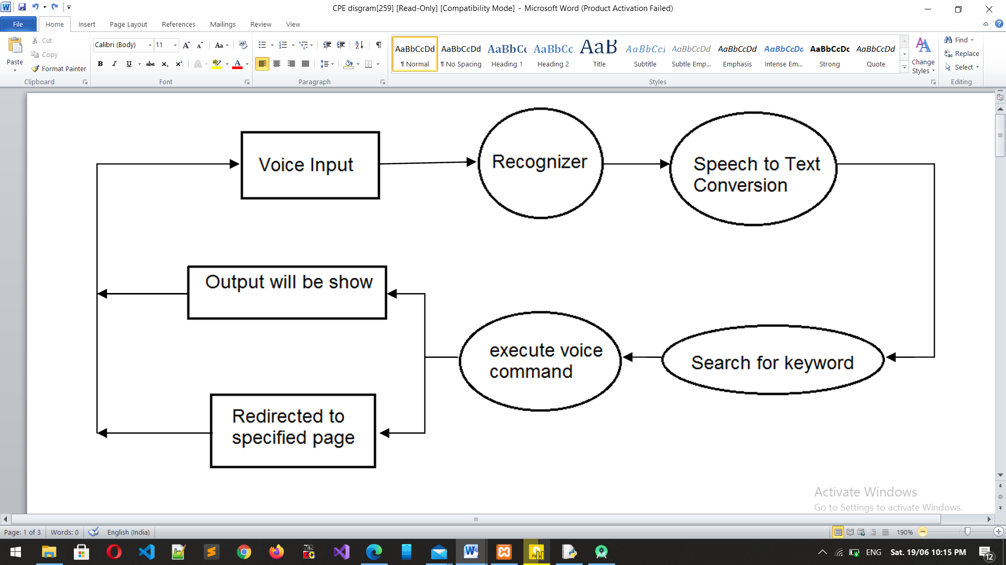
Data flow Diagram

Slide 11
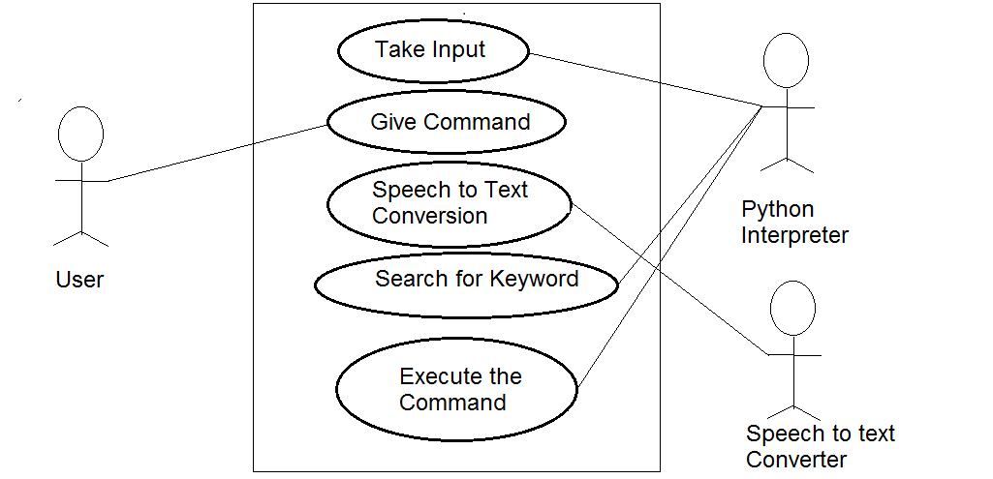
Use Case Diagram

Slide 12
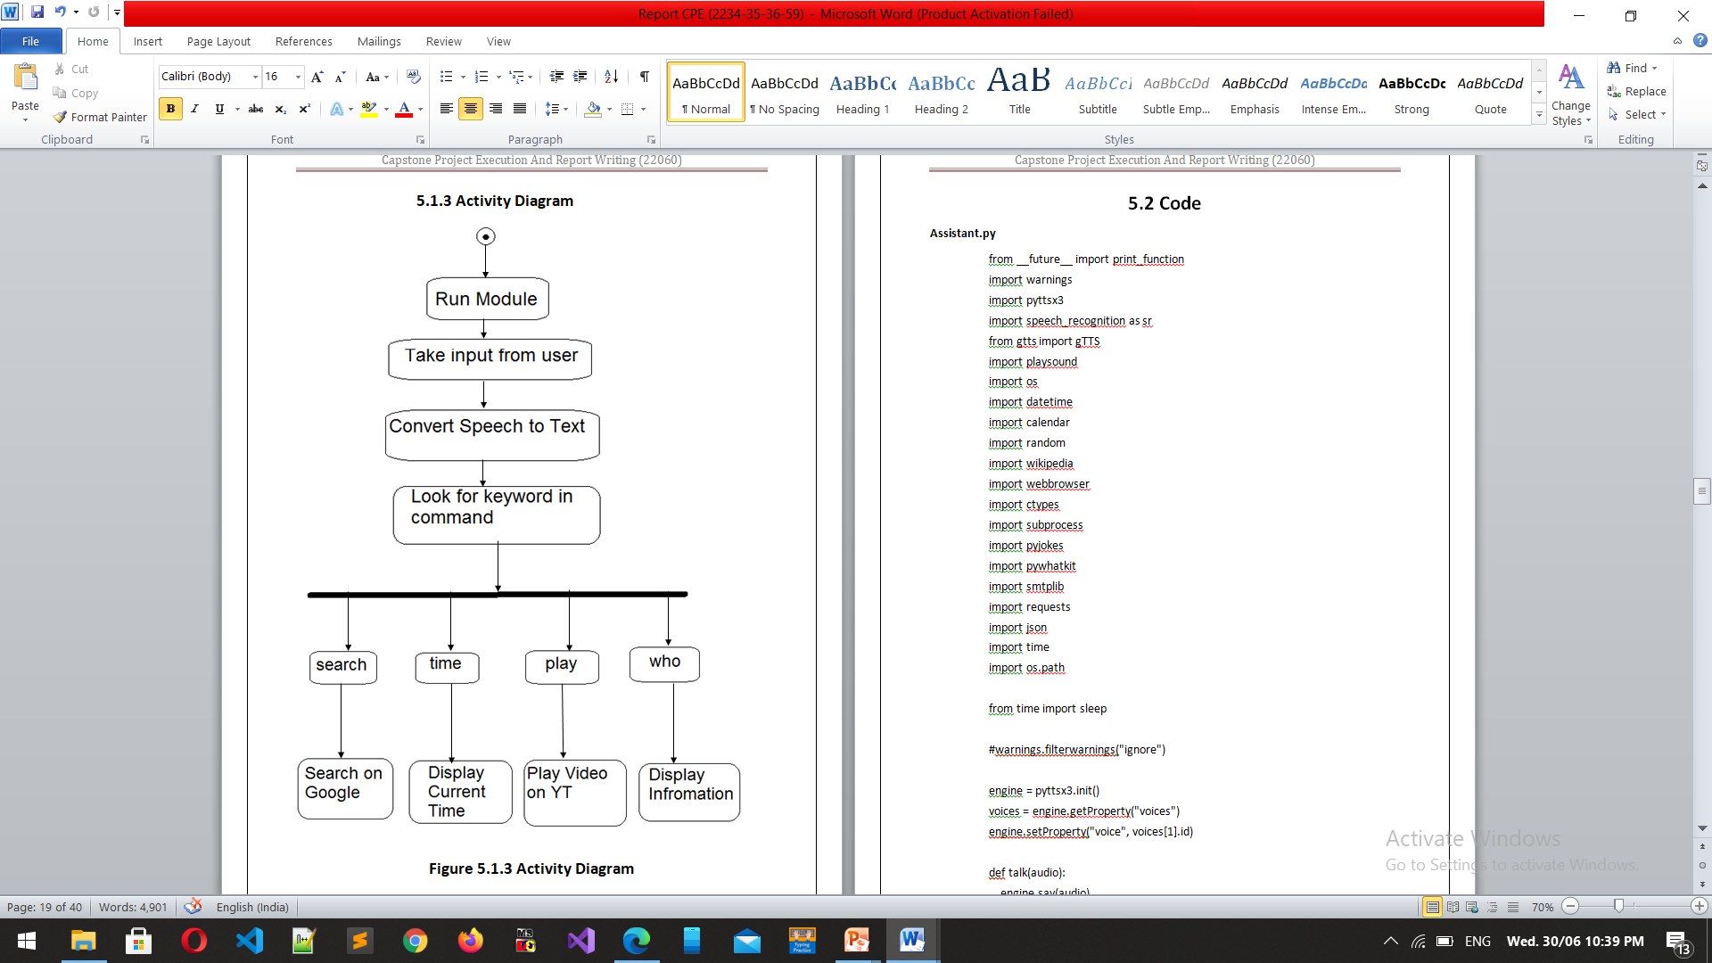
Activity Diagram

Slide 13
Snapshots -

Slide 14
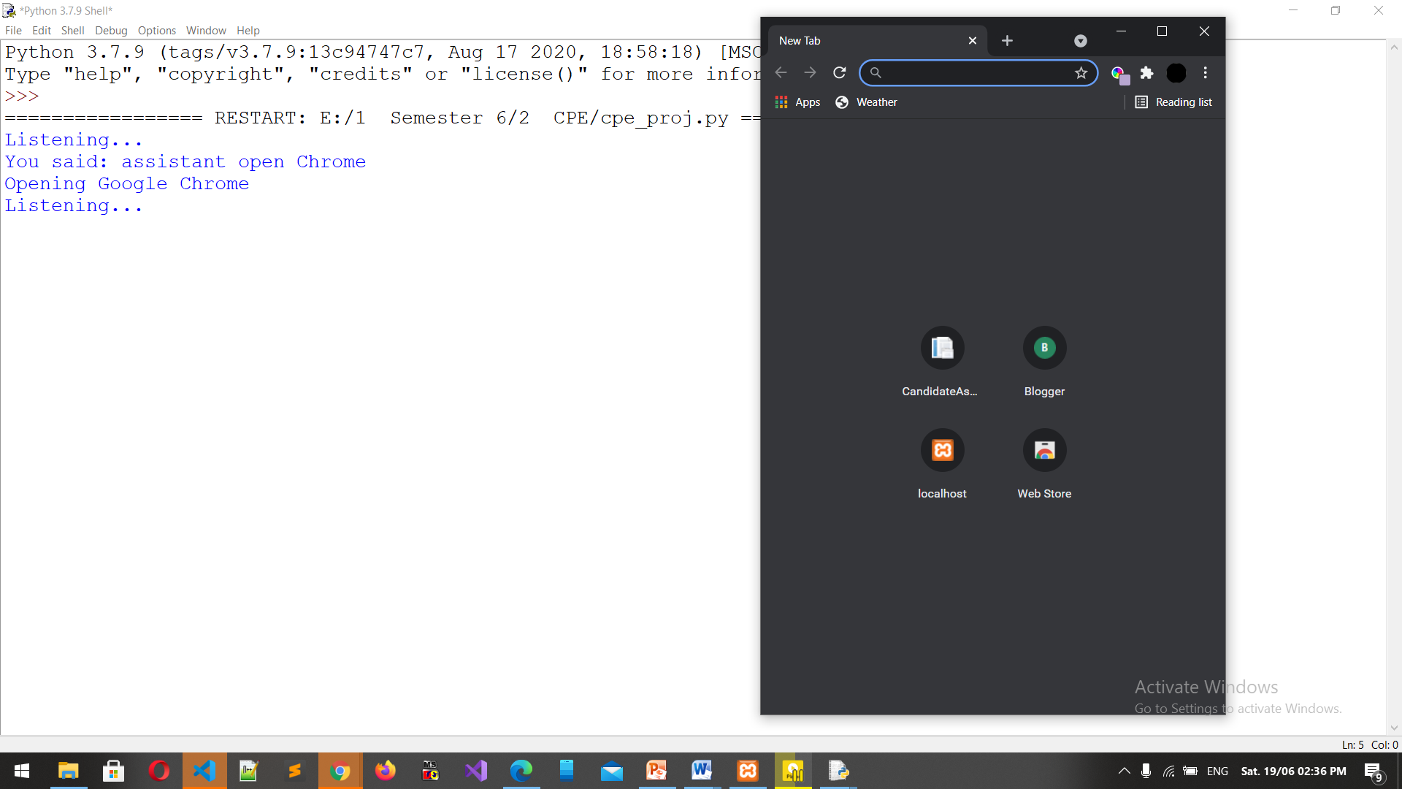

Slide 15
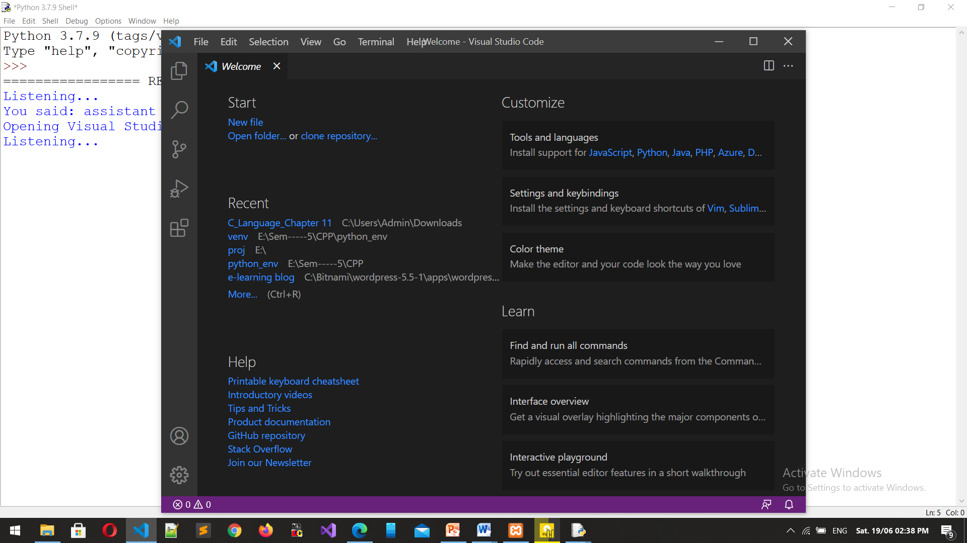

Slide 16
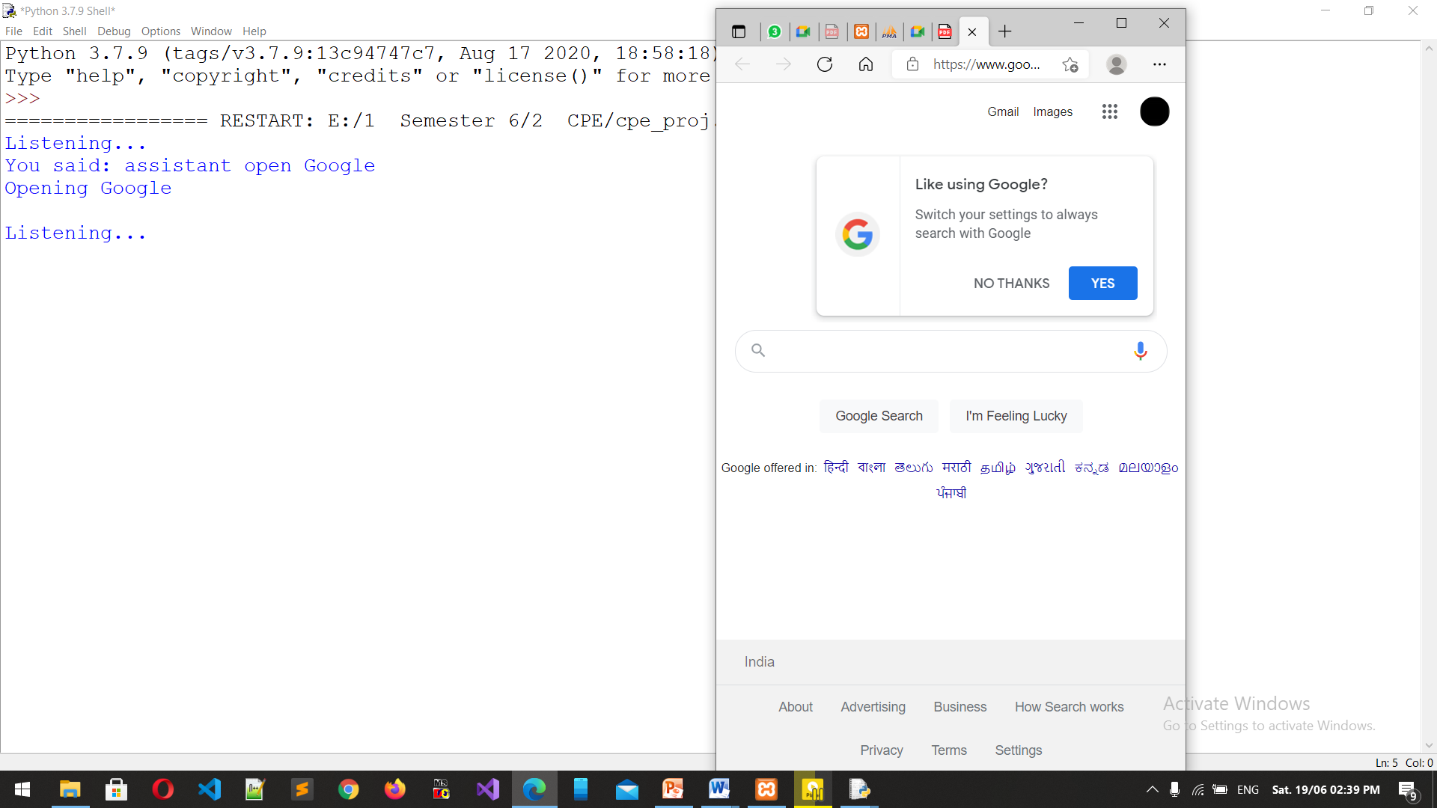

Slide 17
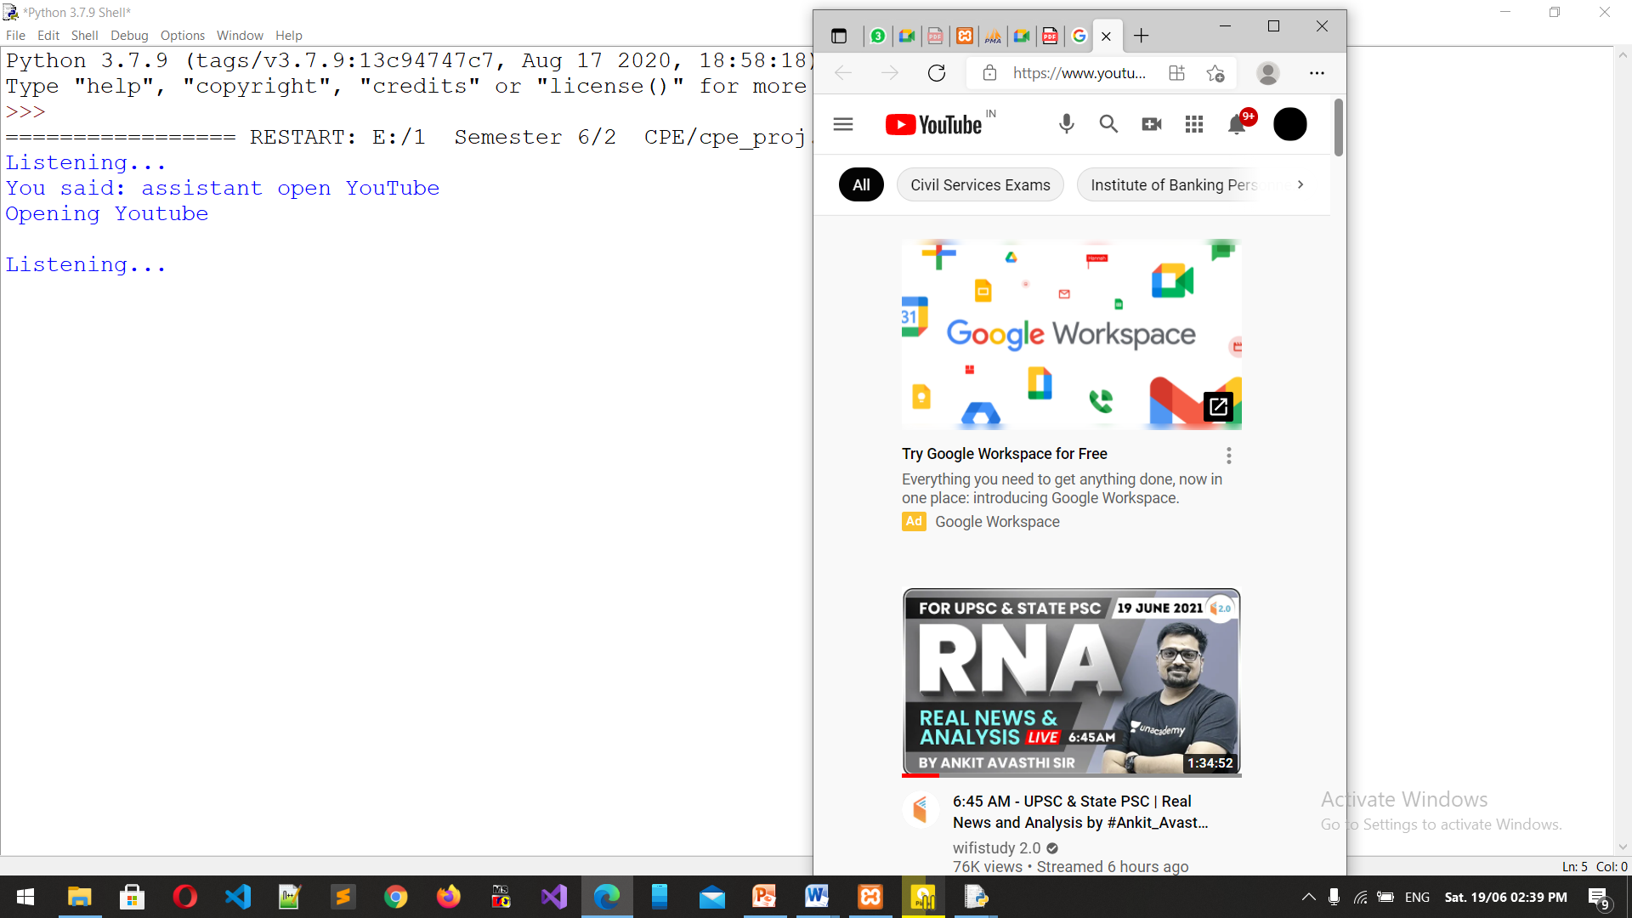

Slide 18
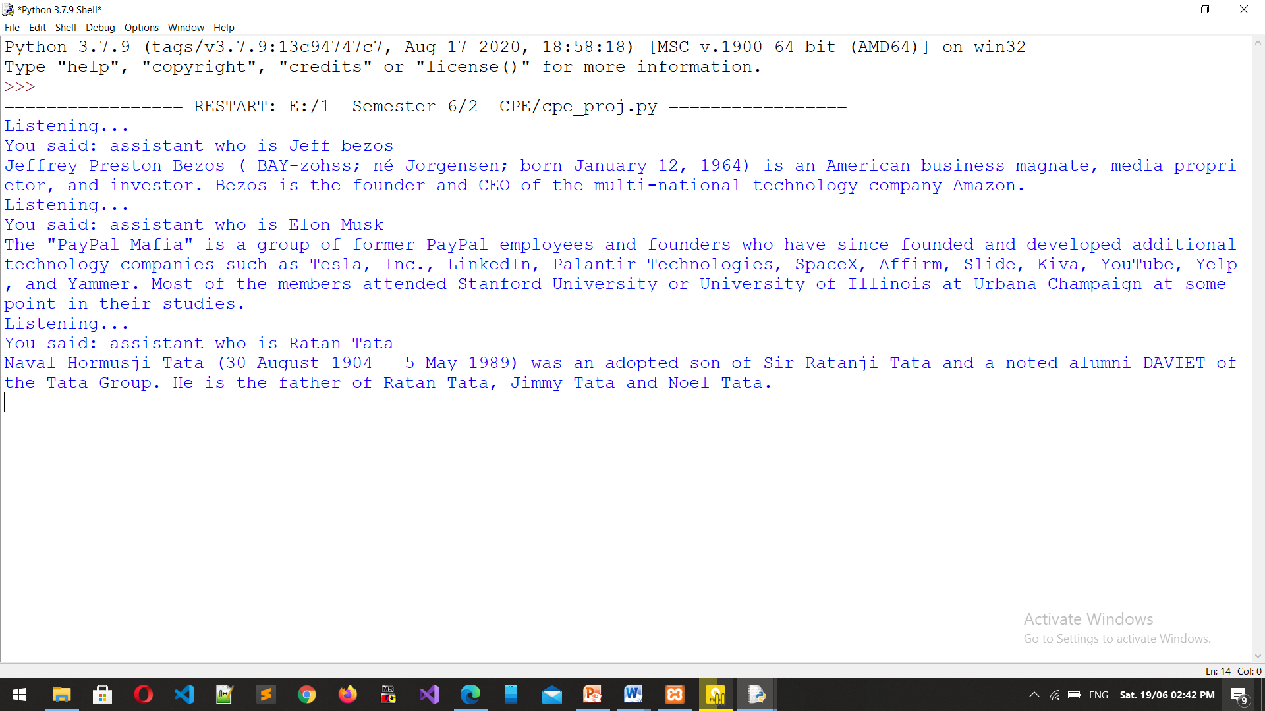

Slide 19
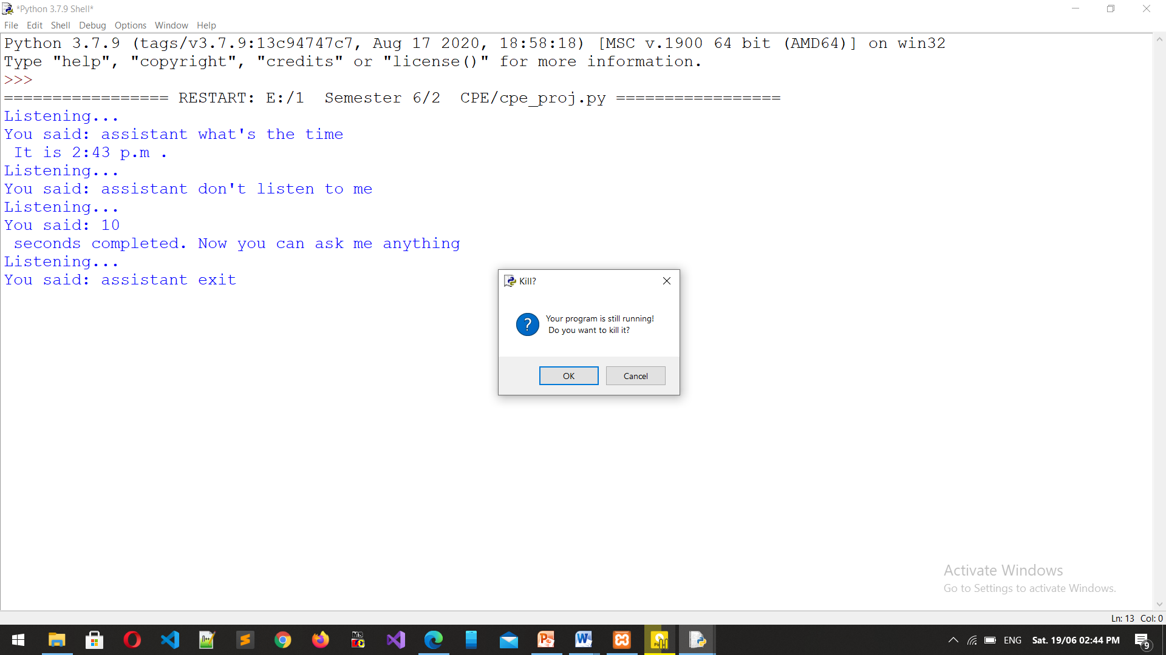

Slide 20
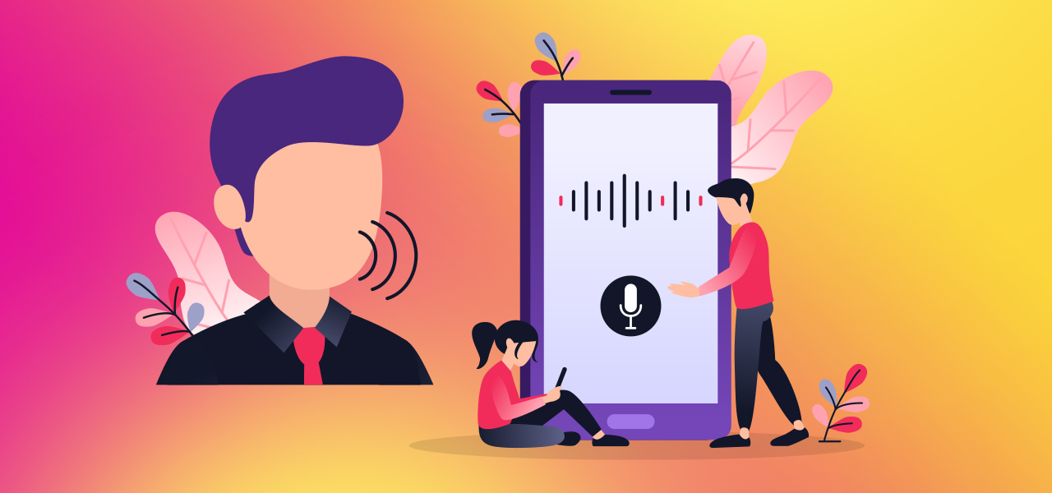
Applications
1. In-Car Systems
2. Health Care
3. Military
5. Telephony and other domains
6. People with disabilities
4. Usage in education and daily life

Slide 21
The Way Ahead …
1. By increasing the training data samples using effective data collection mechanism the domain of recognition can be increased.
2. The system may be enhanced to make work for online mode by integrating it in web applications.
3. The system can be enhanced to apply on the real time applications using telephone.

Slide 22
GANTT CHART – (Overview of 12 week plan)
 | 1 | 2 | 3 | 4 | 5 | 6 | 7
Week 1 | Topic selected |  | Get all basic information
Week 2 | History , Project and Academic Objectives , Scope of the project
Week 3 | Setup Working Environment |  |  | Requirements identified
Week 4 | Basic code done to take input and tested properly
Week 5 | Data-Flow Diagram designed |  |  |  | Summarize completed work
Week 6 | Problems solved in package installation |  |  |  | Code to do search on Google done
Week 7 | Code to identify itself and capable of giving answers of basic questions
Week 8 | Code completed for wikipedia and Video search
Week 9 | Date , time , Joke Modules completed
Week 10 | Code Integrated in a single file – UNIT and Integration testing performed
Week 11 | Alexa don’t get tired even if you ask questions repeatedly – while function
Week 12 | Tested with almost all types of input by different users

Slide 23
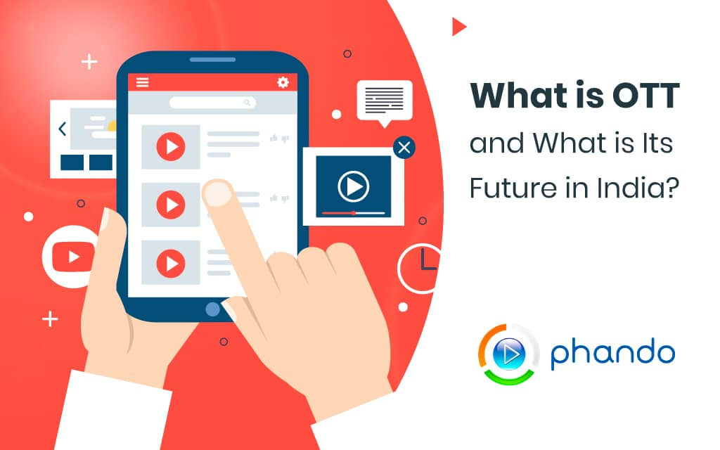
Conclusion
Speech Recognition has become very important in today’s world.
With the advancements in technology and improvements in recognition algorithms, speech has become the primary source of input for many applications.
So, it is intuitive that speech recognition systems have found applications in massive fields. Different obstacles and limitations were overcome by this project.

Slide 24
THANKS!
Any questions ?

